Slide 1
The Central Concepts of Economics
From:
Book 2: Chapter 1 (A, B, C)

Slide 2
Scarcity and Efficiency: The Twin Themes of Economics
A situation of scarcity is one in which goods are limited relative to desires.
Given unlimited wants, it is important that an economy make the best use of its limited resources.
Efficiency denotes the most effective use of a society’s resources in satisfying people’s wants and needs.
Economic efficiency requires that an economy produce the highest combination of quantity and quality of goods and services given its technology and scarce resources.

Slide 3
Economics
Economics is the study of how societies use scarce resources to produce valuable goods and services and distribute them among different individuals.
The ultimate goal of economic science is to improve the living conditions of people in their everyday lives.
Divided into two major subfields:
Microeconomics: concerned with the behavior of individual entities such as markets, firms, and households.
Macroeconomics: concerned with the overall performance of the economy.

Slide 4
Positive Economics versus Normative Economics
Positive economics describes the facts of an economy, while normative economics involves value judgments.
Positive economics: describes and explains various economic phenomena (what is)
normative economics: focuses on the value of economic fairness or what the economy should be.

Slide 5
Positive vs Normative – Examples
The government should provide basic healthcare to all citizens.
Government-provided healthcare increases public expenditures.
Arguing for a higher minimum wage for the benefit of workers.
An assertion that higher minimum wages would lead to a higher GDP.

Slide 6
Three Fundamental Economic Problems
What commodities are produced and in what quantities?
should the emphasis be on agriculture, manufacturing or services, should it be on sport and leisure or housing?
How are goods produced?
who will do the production, with what resources, and what production techniques they will use.
For whom are goods produced?
even distribution? more for the rich? for those who work hard?

Slide 7
Market, Command, and Mixed Economies
Different ways that a society can answer the questions of what, how, and for whom?
A command economy is one in which the government makes all important decisions about production and distribution.
A market economy is one in which individuals and private firms make the major decisions about production and consumption. (it’s extreme case is called a laissez-faire economy)
No contemporary society falls completely into either of these polar categories. Rather, all societies are mixed economies, with elements of market and command.

Slide 8
Inputs and Outputs
Inputs are commodities or services that are used to produce goods and services. Another term for inputs is factors of production.
Land – or, more generally, natural resources – represents the gift of nature to our societies. E.g. land, energy resources, environmental resources.
Labor consists of the human time spent in production – working in automobile factories, writing software, teaching school, or baking pizzas.
Capital resources form the durable goods of an economy, produced in order to produce yet other goods. E.g. machines, roads, computers, software, trucks, steel mills, automobiles, washing machines, and buildings.

Slide 9
Inputs and Outputs (Cont’d)
Outputs are the various useful goods or services that result from the production process and are either consumed or employed in further production.
Consider the ‘Production’ of pizza.
What are inputs and output?
In education. Inputs and outputs?

Slide 10
The Production-Possibility Frontier (PPF)
The production-possibility frontier (or PPF ) Show the different combinations of goods and services that can be produced with a given amount of resources.
No ‘ideal’ point on the curve
All choices along a PPF display productive efficiency
Any point inside the curve (underutilized) suggests resources are not being utilised efficiently
Any point outside the curve (Infeasible) not attainable with the current level of resources
Useful to demonstrate economic growth and opportunity cost

Slide 11
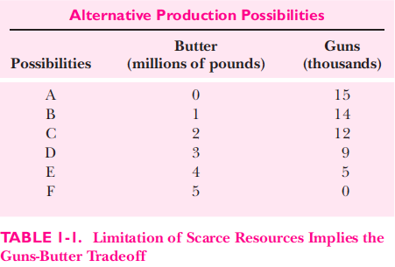
Example: Guns and Butter
Consider an economy which produces only two economic goods: guns and butter.

Slide 12
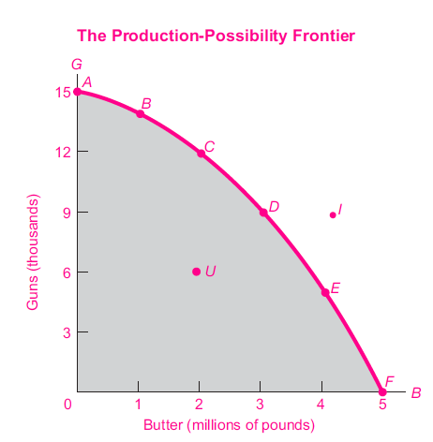
Example: Guns and Butter (Cont’d)

Slide 13
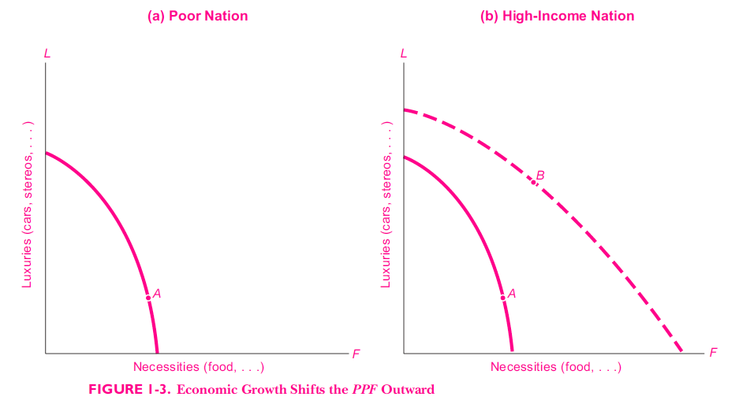
Applying the PPF to Society’s Choices

Slide 14
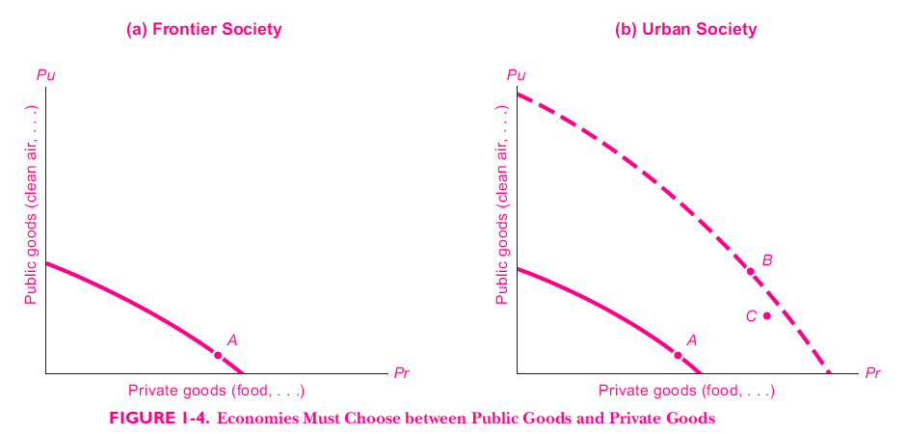
Applying the PPF to Society’s Choices
Private goods: bought at a price
Public goods: paid for by taxes

Slide 15
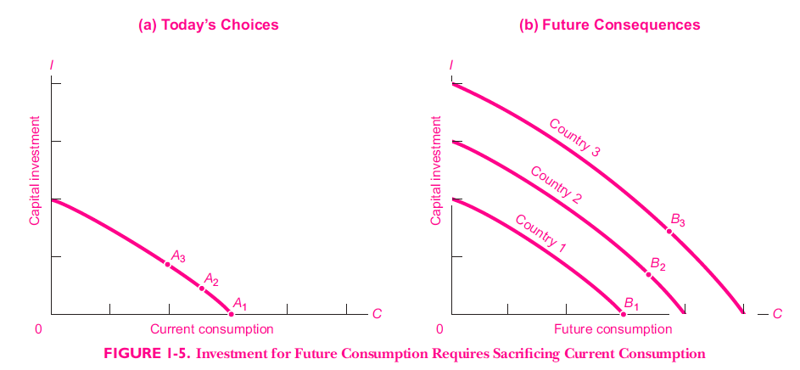
Applying the PPF to Society’s Choices

Slide 16
Opportunity Costs
In a world of scarcity, choosing one thing means giving up something else. The opportunity cost of a decision is the value of the good or service forgone.
Decisions involve tradeoffs. When you make a choice, you give up an opportunity to do something else.
The highest-valued alternative you give up is the opportunity cost of your decision.
Guns-butter tradeoff example

Slide 17
Opportunity Costs – Scenario
Identical twins A and B with Bachelors degrees and receive the same job offer. A passes up the job offer to pursue a Masters degree while B takes the job offer and begins working.
Two years pass and A graduates and begins working. By this time B has been promoted to a position that is comparable to A’s starting position, and B’s salary has increased to an amount that is comparable to A’s starting salary.
Who made the better decision, A or B?

Slide 18
Opportunity Costs (Cont’d)
In business and in life, every choice we make comes at a cost since we forgo other possible alternatives in the process; this cost — whether it’s money, time, education, health, etc. — is known as an opportunity cost.
Ultimately, opportunity costs apply to anything which is of value to a person and being conscious of how they apply to your situation can help in making a satisfactory choice/decision by considering the value or benefit of the next best alternative.

Slide 19
To Practice
Book 2 (Page 24)
Question No. 1 to 4

